Slide 1

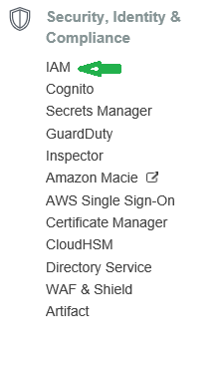
AWS Security, Identity & Compliance
Notes:
https://docs.aws.amazon.com/IAM/latest/UserGuide/best-practices.html
https://aws.amazon.com/iam/

Slide 2

IAM Identity and Access Management
Notes:
https://docs.aws.amazon.com/IAM/latest/UserGuide/best-practices.html

Slide 3
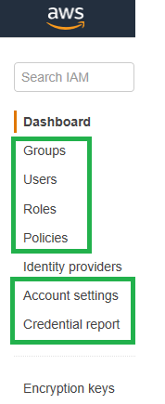
IAM Identity and Access Management
Notes:
https://docs.aws.amazon.com/IAM/latest/UserGuide/best-practices.html

Slide 4
IAM
ORG
FinanceGroup
Nancy
ITGroup
Peter
Tom

Slide 5
Q&A
?????
Notes:
Demo:
#!/bin/bash
yum install -y httpd
echo "<html><body><h1>Welcome! </br> AWS + DevOps </h1></body></html>" > /var/www/html/index.html
service httpd start

